Slide 1
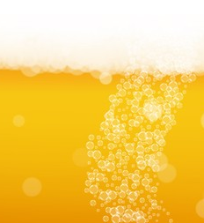
Budweiser Marketing Campaign
Team: Data Dynamos
July 1, 2020

Slide 2
Questions Asked
Provide Details on the Beer Market Data Set and any associated issues.
Describe the Beer Characteristics within the overall market.
Show Points of Interest within the Data.
Tell us about the Alcohol content between beers.
Tell us about the relationship between alcohol and bitterness.

Slide 3
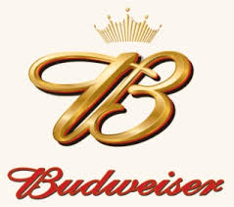
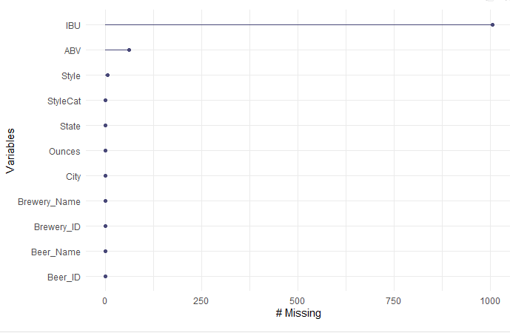
Data Facts
2,692 Distinct Beers
558 Distinct Breweries
99 Distinct Styles Listed
Eight Separate Fields
However, Not All Data Is Provided!
Missing Values For:
IBU: | 1,005
ABV: | 62
STYLE: | 5

Slide 4
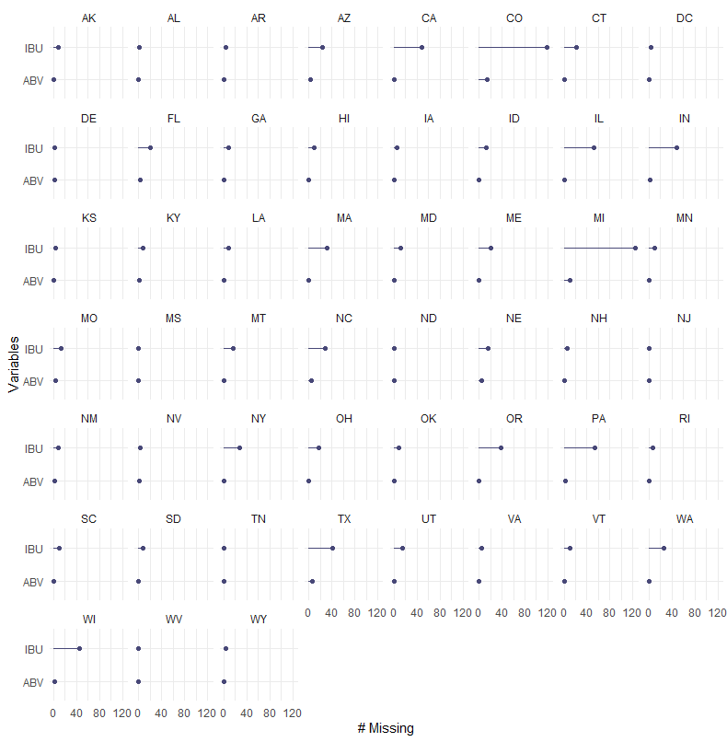
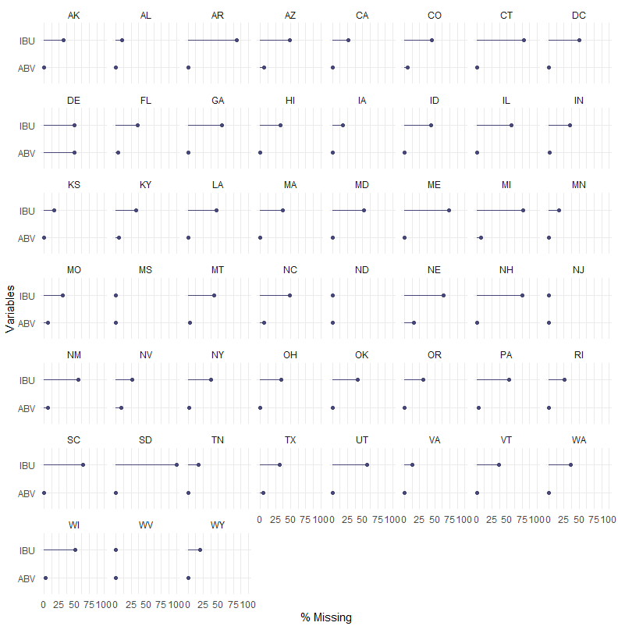
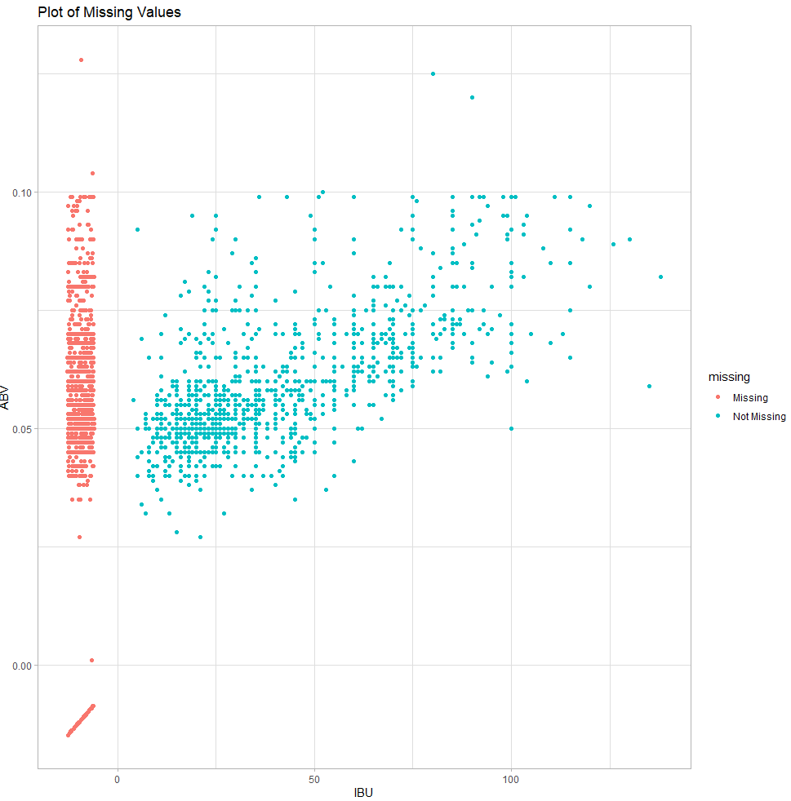
Focusing on the Missing Values in IBU and ABV
First Chart shows missing values by state count and percent.
Second Chart shows distribution of the missing values.

Slide 5
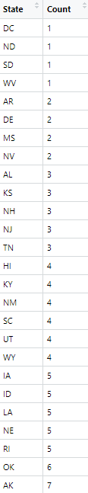
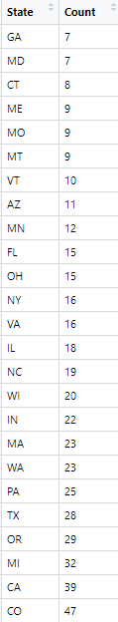
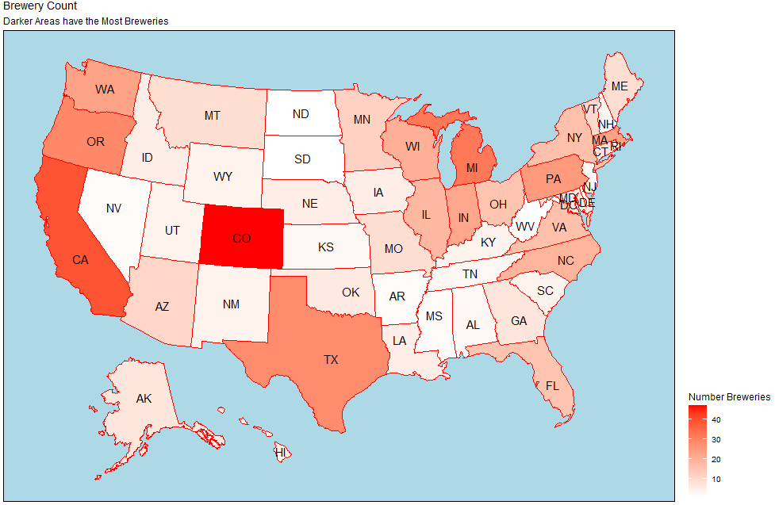
How Many Breweries Are In Each State?

Slide 6
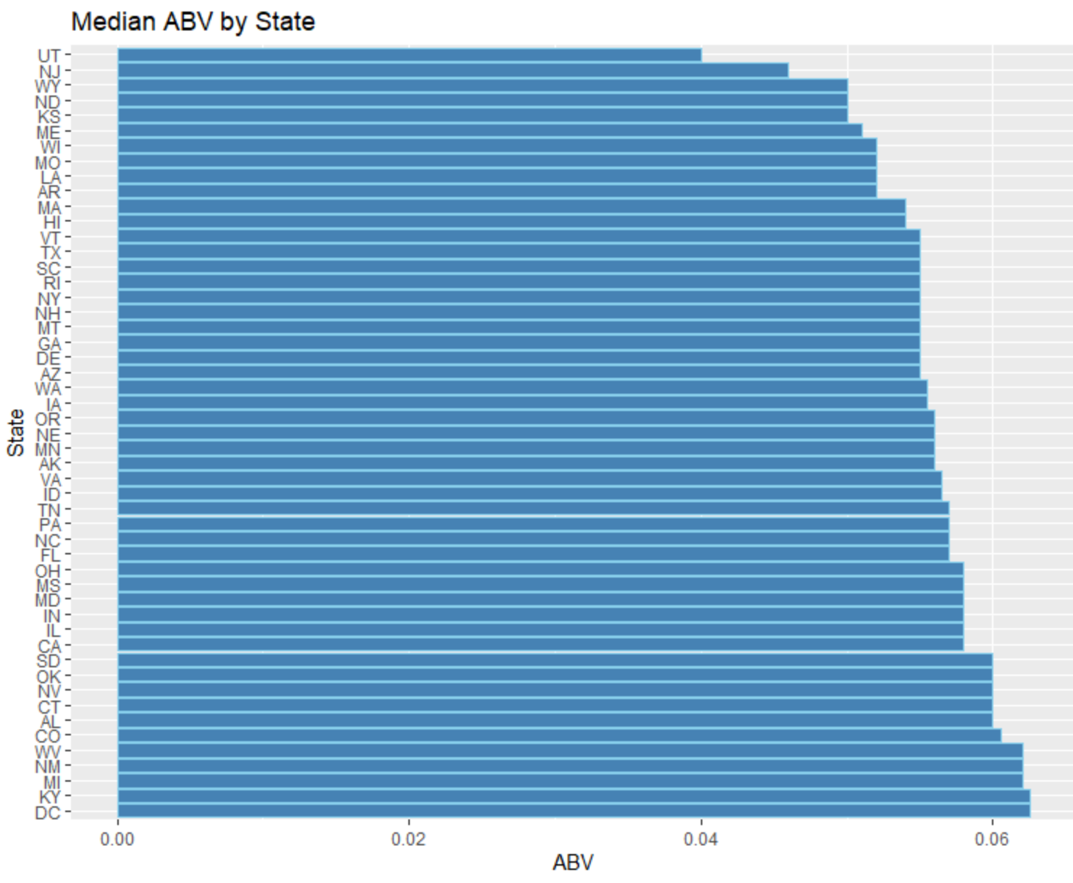
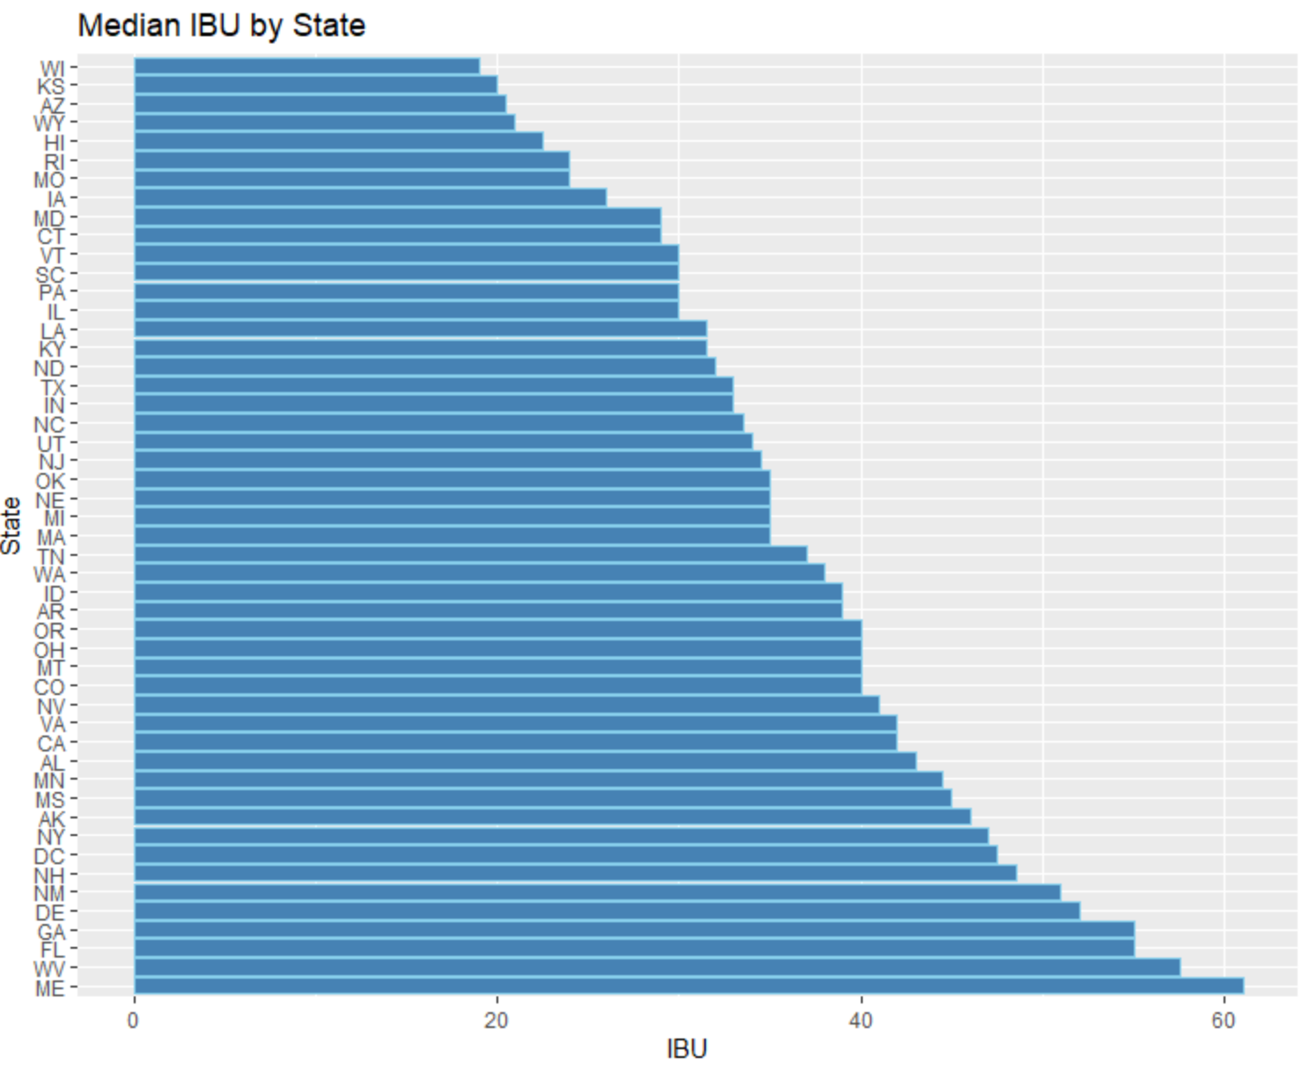
Comparing the Median ABV and IBU by State
When looking at the Median for ABV and IBU, the ABV looks somewhat uniform and IBU seems to have more variation.
Min ABV: Scotty K NA from CA with ABV of 1% | Min: 3 versions of Summer Solstice from CA with IBU of 4
Max ABV: Lee Hill Series Vol. 5 - Belgian Style Quadruple Ale from CO with ABV of 12.8% | Max: Bitter Bitch Imperial IPA from OR with IBU of 138

Slide 7
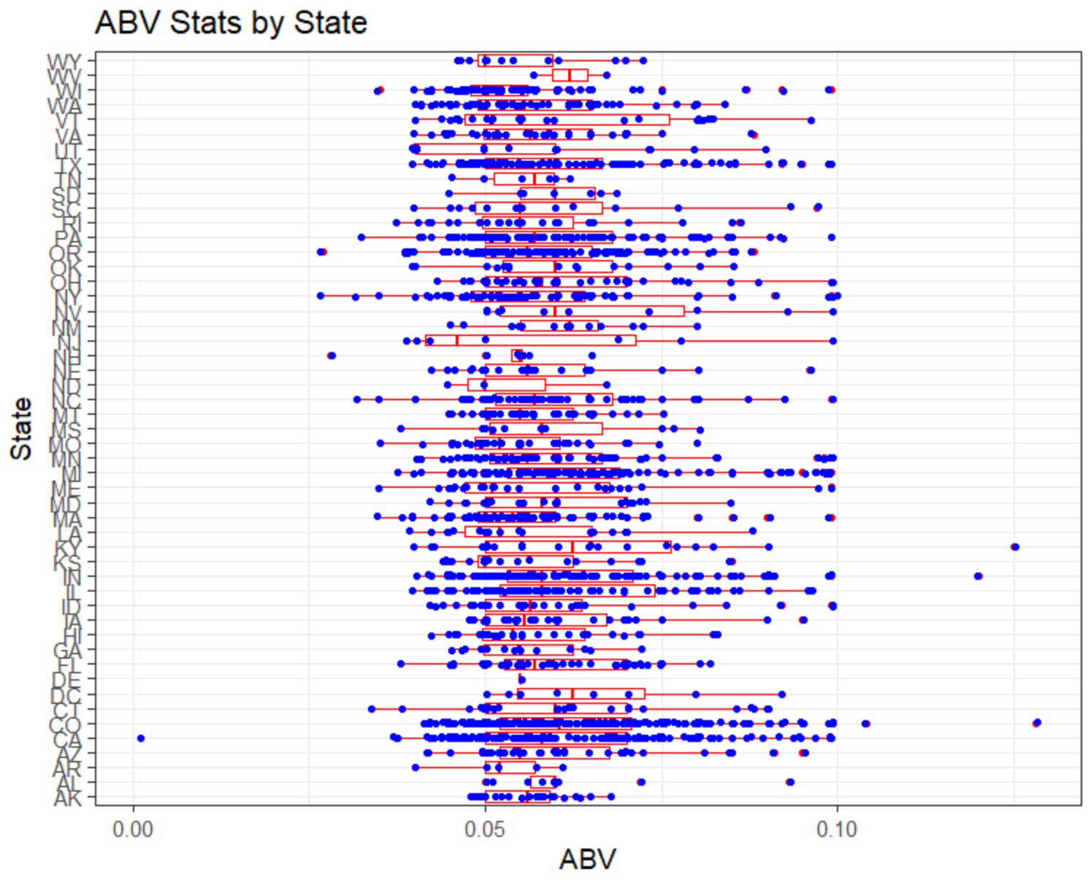
ABV Compared by State
Quite a bit a variation, even within the states
Consumers are demanding niche and craft beers

Slide 8
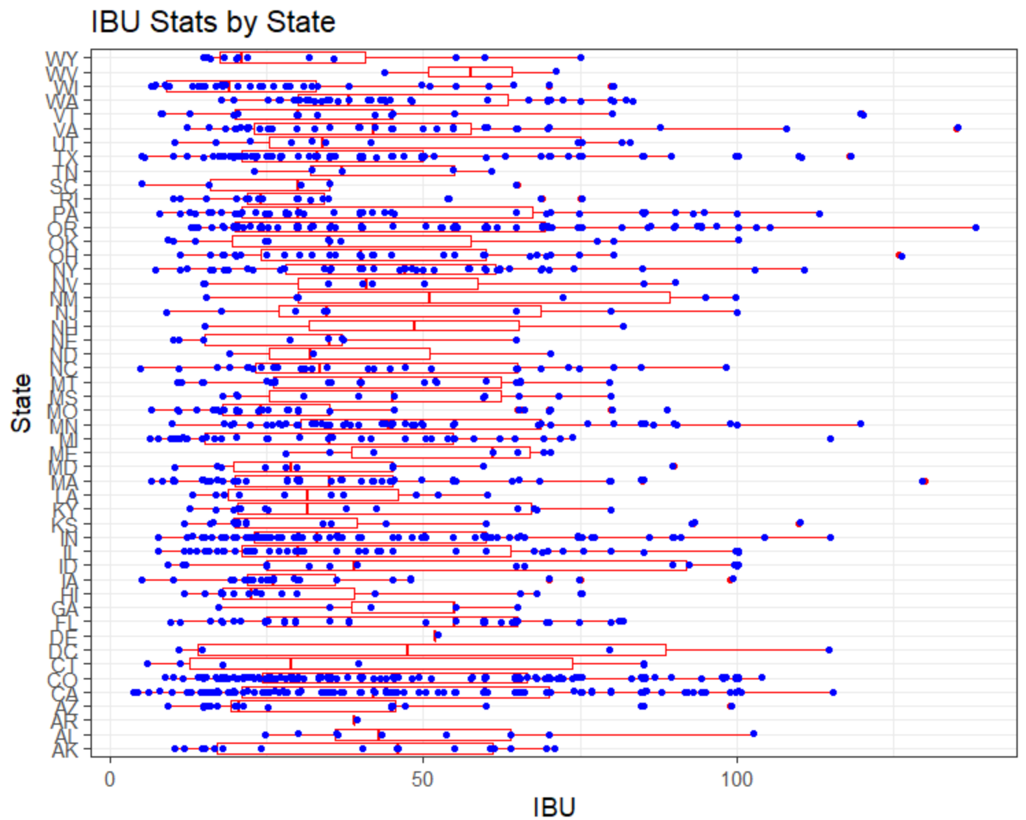
IBU Compared by State
Less variation as compared to ABV
Amount of variation is likely the same as ABV as seen from Scatter Plot
Data Quality is important

Slide 9
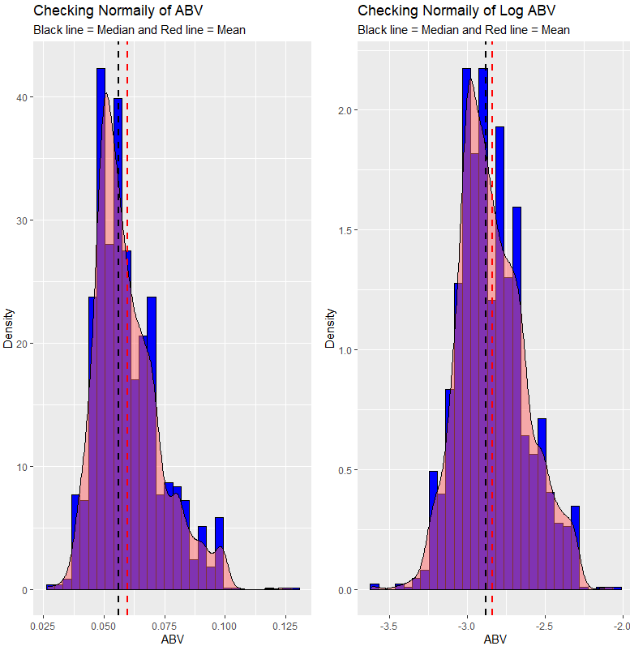
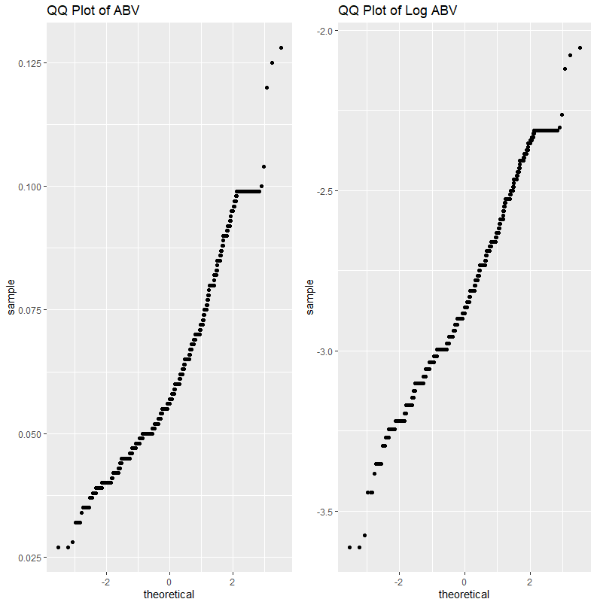
Distribution of the ABV Variable
The 1 Non-Alcoholic Beer is skewing data (see min value) so it was dropped.
ABV looks fairly normal, but is improved with a log transformation
Min.: 0.00100
1st Qu.: 0.05000
Median: 0.05600
Mean: 0.05977
3rd Qu.: 0.06700
Max.: 0.12800

Slide 10
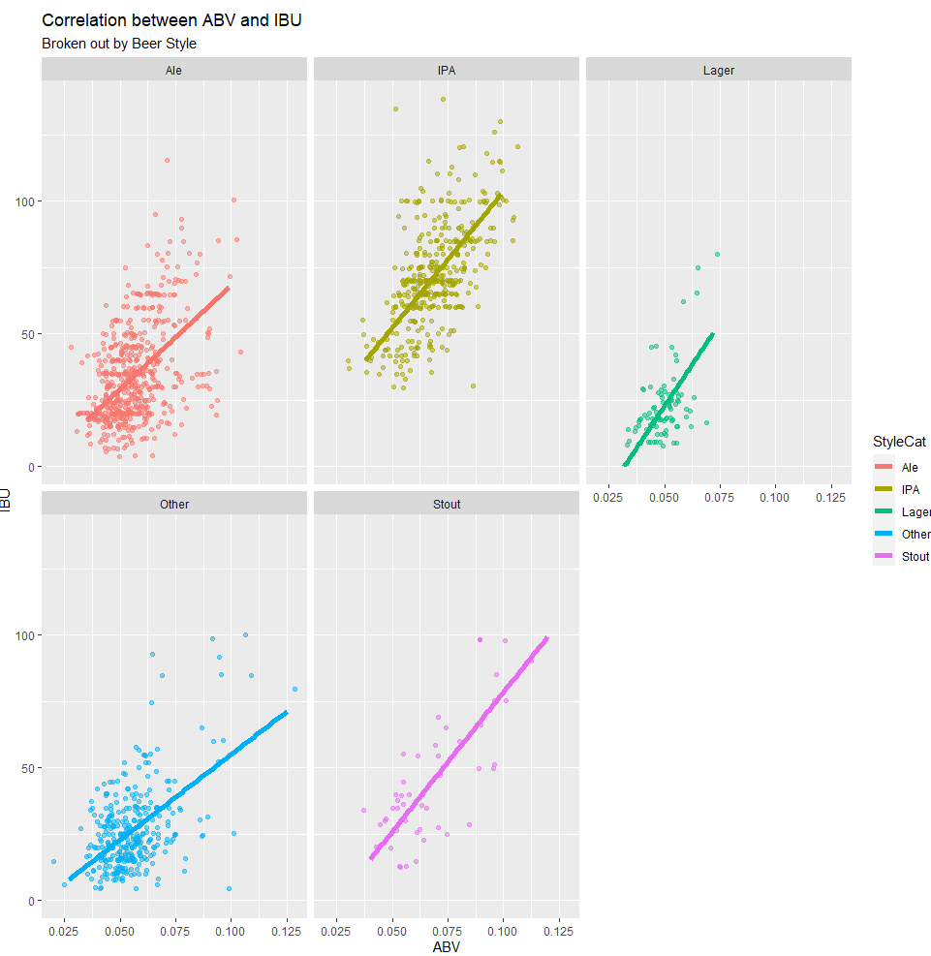
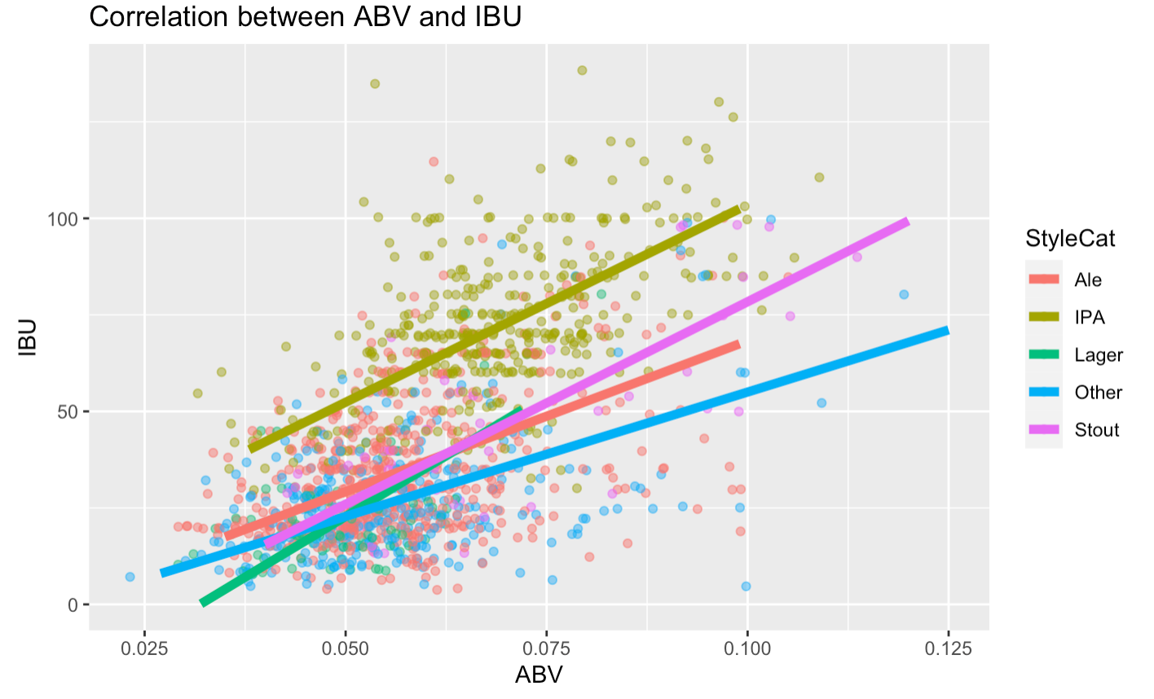
Relationship Between Beer Bitterness and Alcohol Content
There is a moderate positive correlation between ABV and IBU. The upward slope is evidence of a positive relationship.
At the same level of alcoholic content, IPA type of beer is more bitter than an Ale, Lager or Stout
When looked at individually the steeper relationship can be seen in Stouts and Lagers

Slide 11
Next Steps
Continue Looking through data to find points of interest
Produce a video with our findings and final recomendations
Questions?

